Slide 1
EDUp project name Project Setup template
Vienna, April.2022
Edu Platform
MSc. Ömer Karacan
karacankos@gmail.com

Slide 2
Project Purpose

Slide 3
Project Requirements

Slide 4
Project Technical Scope

Slide 5
Project Setup

Slide 6
Project Delivery

Slide 7
Additional Considerations

Slide 8
References

Slide 9
<Annex - > <topic name>>

Slide 10
Project Glossary

Slide 11
IDEA: funnel template is a check-list!
roles are important
customer deivers only the use cases --> customer req doc
assumption: customer has not technically profonde knowledge over the FORDCS
WHO is customer? SmartCity Gov!!??!!
EDUp is the supplier, has knowledge about the FORDCS
EDUp sys-req contains req-analysis based on use-use-cases --> state machine models and swagger design --> (analysis phase)
swagger design is input for validation test spec
Project STORY : Analysis design dev -- devops -- test : Dev Life-Cycle Story & PM story (work-funnels)

Slide 12
Backyard

Slide 13
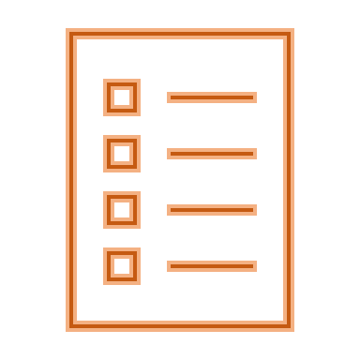

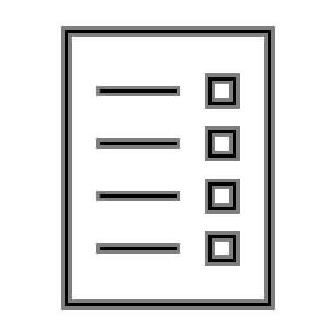

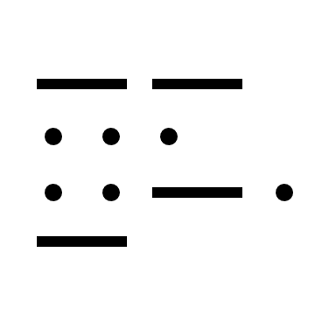




Full-Stack Software Project Development Method
<project>
Customer Requirements Document
<project>
Test Code
<project>
Customer Requirements Document
Project Setup Work-stream
<project>
Project Setup
<project>
Validation Test Specification
Requirements Analysis Work-stream
<project>
System Requirements Specification
Acceptance Test Work-stream
<project>
Validation Test Specification
<project>
System Requirements Specification
System Test Work-stream
<project>
Test Code
<project>
Test Code
Architecture Design Work-stream
<project>
Architecture Design Specification
Test Code Work-stream
<project>
Architecture Design Specification
<project>
Validation Test Specification
Integration Test Work-stream
DevOps Document
Implementation Work-stream
<project>
Component Code
<project>
Verification Test Specification
<project>
DevOps Document
<project>
Component Code
DevOps Work-stream
Unit Test Work-stream
Cycles
Text Template: <artifact-name> work-stream)

Slide 14
EDUp Project Story Stream Checklist
The < project-name>
Customer Scope
Define the system boundaries
Define the scope of the customer needs/requirements
Describe the needs from the viewpoint of customer (use case, swagger-UI, UX, big-picture)
Define the customer's knowhow profile
Supplier (Project) Scope
Define the system requirements from the viewpoint of supplier (describe with the means of Supplier's technology, tools, ..., HW/SW big-picture)
Define the supplier's knowhow profile
Define a project roadmap (project timeline)
Create artifacts according to EDUp-Full-Stack-Software-Project-Development-Method.pptx
See slide “Full-Stack Software Project Development Method” (#4)
Define the sys/sw-architecture covering the sys-req component-wise (SOA, component-based arch, domain model)
Define alternative solutions and references
Define the components based on Spring architecture
Define DevOps (the dev-env and dev-ops)
Define V&V-spec and -env
Define Deployment (deliverables, release content and media)

Slide 15
EDUp Project Story Stream
00
00
00
00
Customer Scope
00
00
00
00
Supplier Scope
User Scope

